Slide 1






PHISHING AWARENESS TRAINING
PREPARED BY : KARAN PATHAK

Slide 2
TABLE OF CONTENTS
Phishing, Types, Working | What is phishing, what are its types and how does it work ?
Real World Examples | Screenshots of Phishing Emails / Websites
Recognising fake Emails/Sites | Eg :- Red flags in emails (grammar errors, suspicious links, sender mismatch)
Social Tactics Used | What are the Social Engineering Tactics used by Attackers
How to Avoid this Attacks | Ways to Prevent and Avoid Phishing Attacks
Test Quiz | Small Quiz to check whether you can now detect fake Emails
Tools and Technologies to Help | What are the Tools and Technologies that can be used to avoid Phishing

Slide 3
WHAT IS PHISHING ?
Phishing is a cyberattack where attackers trick people into sharing sensitive information by pretending to be a trusted source.

Slide 4
How is Phishing Done ?
Attackers create a fake message or website that looks legitimate.
They lure you to click a link or open an attachment.
The link steals your credentials or installs malware, or tricks you into giving sensitive info.

Slide 5
TYPES OF PHISHING :
01
Email phishing
02
Spear phishing
03
Sms phishing (smishing )
04
Clone phishing
Voice phishing ( vishing )
05

Slide 6

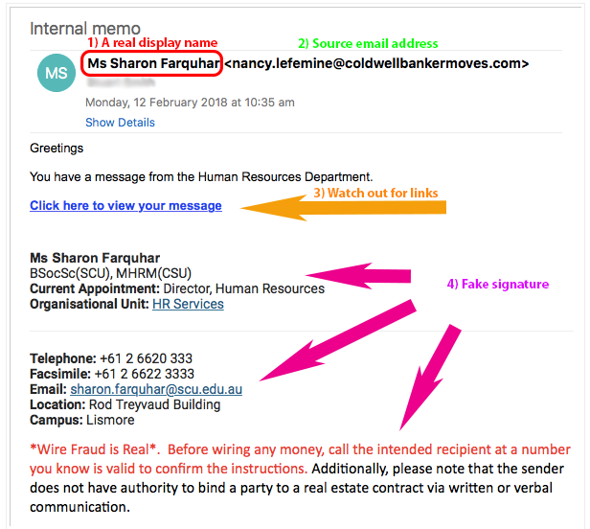
Example of Fake Email

Slide 7
HOW TO RECOGNIZE FAKE EMAILS / WEBSITES ?
Suspicious links/URLS
Poor Grammer and Spelling
01
02
Urgent and Scary Message
Unusual Sender Address
03
04
fake sites often use misspelled or unusual domains
Legit organizations rarely send emails with frequent errors
“Act now” or “Your account will be blocked” are common phishing tactics
The email may come from a lookalike address, not the official one

Slide 8
SOCIAL TACTICS Used By Attackers
URGENCY
FEAR
CURIOSITY
GREED/REWARD
AUTHORITY
Forcing for Quick Action
Threats for loss, Fines, Punishment
Tempting Links and Attachments that Spark Interests
Promises of Prizes, Money
Pretending to be Bosses, Banks, Or Officials

Slide 9
HOW TO AVOID PHISHING ATTACKS
ENABLE MFA (Multi Factor Authentication :
KEEP SOFTWARE UPDATES :
Adds extra security even if credentials leak
Regular updates patch security holes attackers exploit
DON’T SHARE SENSITIVE INFO :
VERIFY LINKS AND EMAILS :
Never give passwords, OTPs, or bank details
Always check the Sender and URL before Clicking

Slide 10
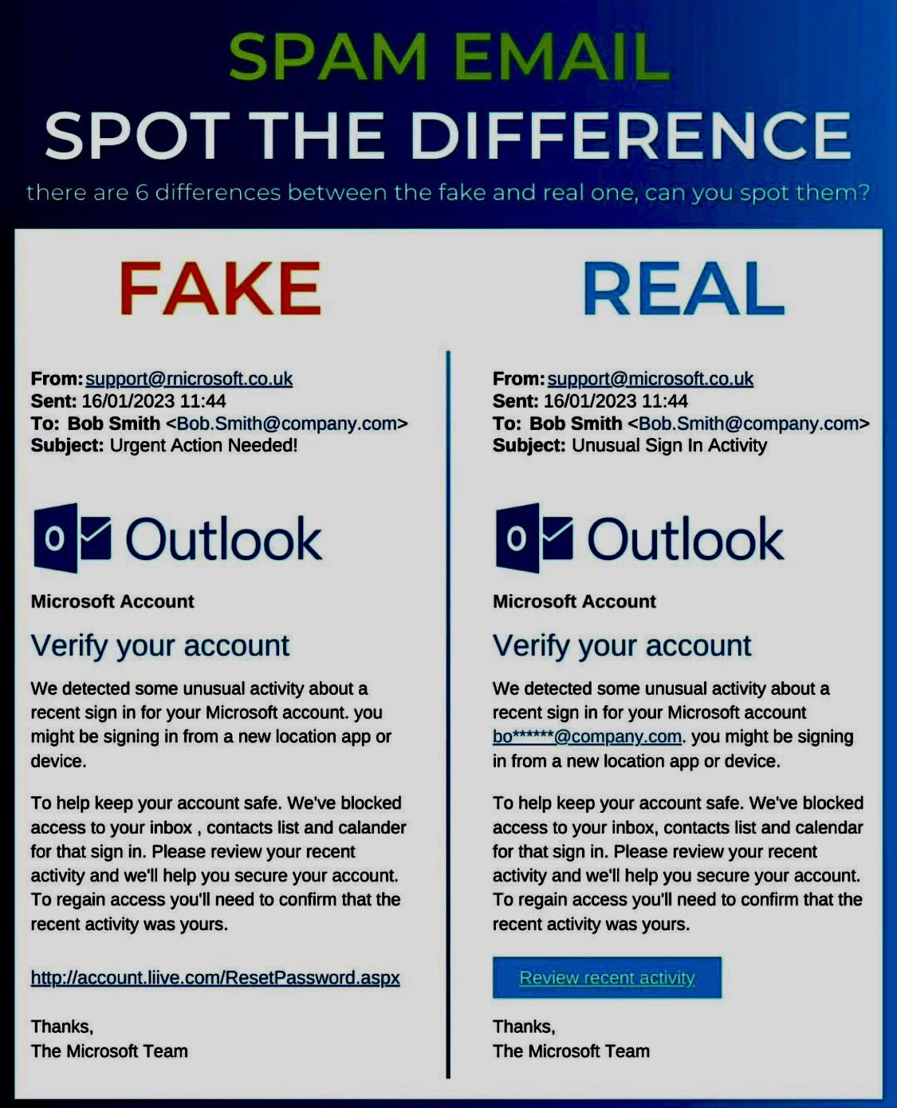
QUIZ FOR BETTER EXPLANATION
1. Spot The Fake And Real E-mail
ANSWER : 2nd One is real .

Slide 11
2. MCQs :
What Is Biggest Red Flag In Phishing Email ?
A) Correct Grammar B) Urgent Action Required
C) Known Sender D) Company Logo
Phishing Mainly Aims To Steal __________
A) Personal And Financial Info B) Free Movies
C) Computer Speed D) Internet Data
Answers : 1. B 2. A

Slide 12
3. TRUE OR FALSE :
Phishing emails always come from unknown senders.
Hovering over a link can reveal the real URL
( Answers : 1. FALSE
2. TRUE )

Slide 13
TOOLS AND TECHNOLOGIES USED FOR PROTECTION :
01
E-mail Filters and Spam Blockers
02
Anti-Phishing toolbars and Browser Extensions
03
SSL Certificates and HTTPs
04
Security Awareness Training Platforms
05
Endpoint Security Software
06
Firewall and Intrusion Detection Systems

Slide 14
ANY QUESTIONS / SUGGESTIONS ?
THANKS FOR GIVING YOUR SUCH A VALUABLE TIME .

